Slide 1
G5 - Smart Office Cleaner Robot

Slide 2
Objective
Main goal is to prepare robust, inexpensive affordable product with better efficiency

Slide 3
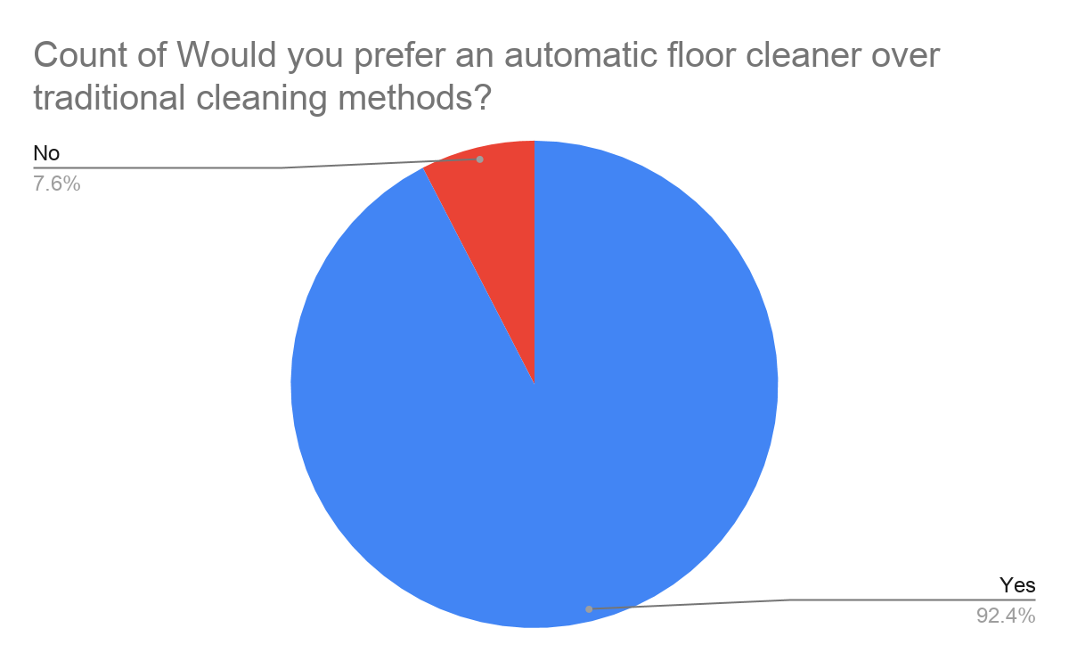
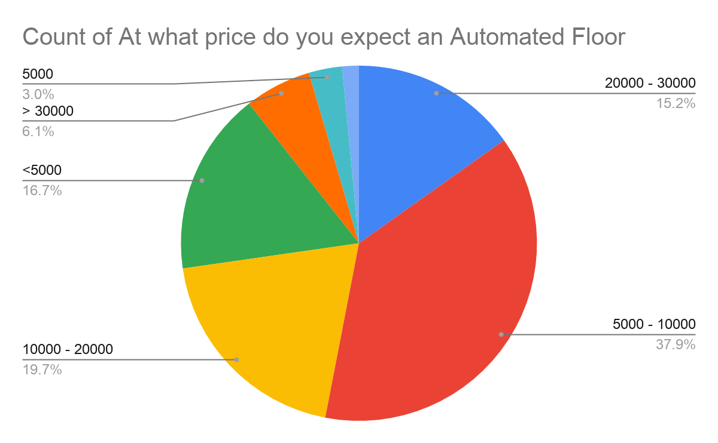
Customers’ Survey

Slide 4
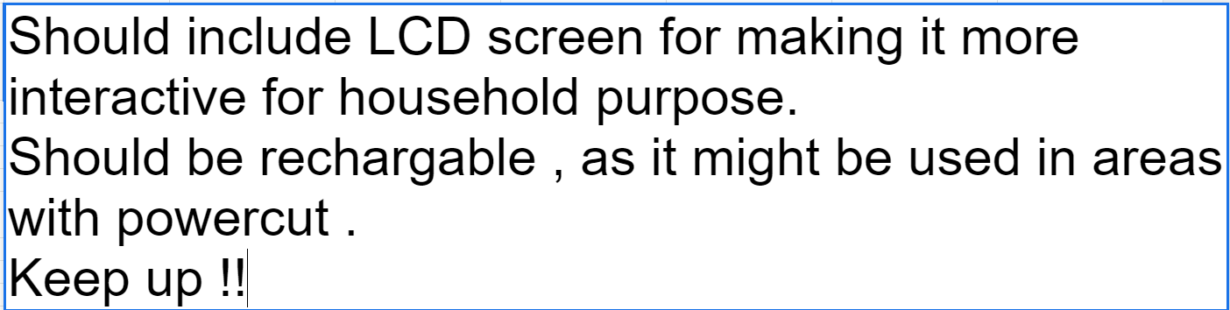
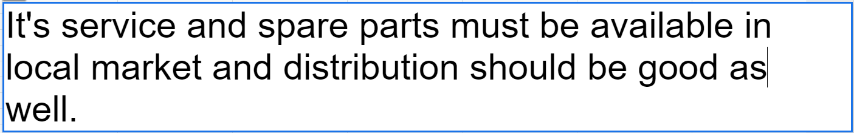
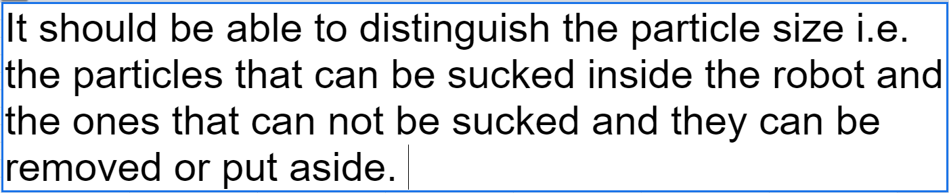
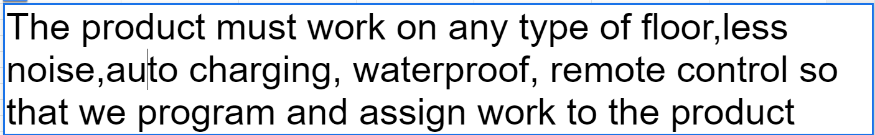
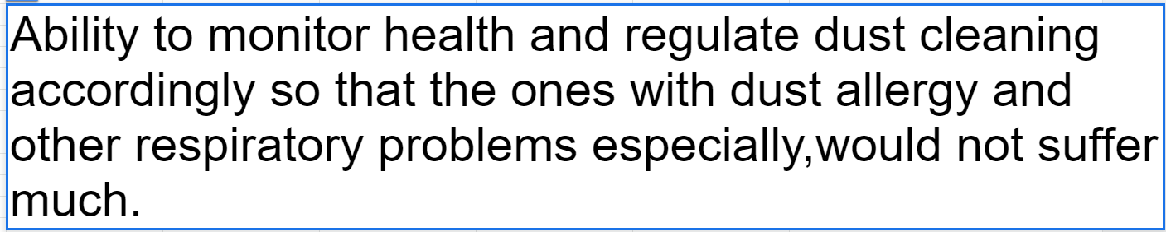
Customer Demands

Slide 5
COMMUNICATION BETWEEN MICROCONTROLLER AND
APPLICATION
SENSORY INPUT TO MICROCONTROLLER
WELL CALCULATED, PRECISE WORKING OF THE CLEANER ROBOT
EFFECTIVE FEATURES AND MECHANISMS
PROCESSING AND MAPPING USING INPUTS FROM MICROCONTROLLER
OPERATION METHODOLOGY

Slide 6
Features to be added
Dry cleaning
Wet Mopping
UV Sanitisation
Obstacle Avoidance
Manual/Autonomous Control
Terrain Mapping
Smartphone Connectivity (WiFI)

Slide 7
Electronics to be used
Wifi Microcontroller
Motors with wheels(DC, Servo)
LIDAR sensor & other sensors
LCD Screen
Battery
Sprayer, Blow dryer & Vacuum Pump
UV Light

Slide 8
Parts to be fitted
Brushes
Mop roller
Dustbin
Water cylinder

Slide 9
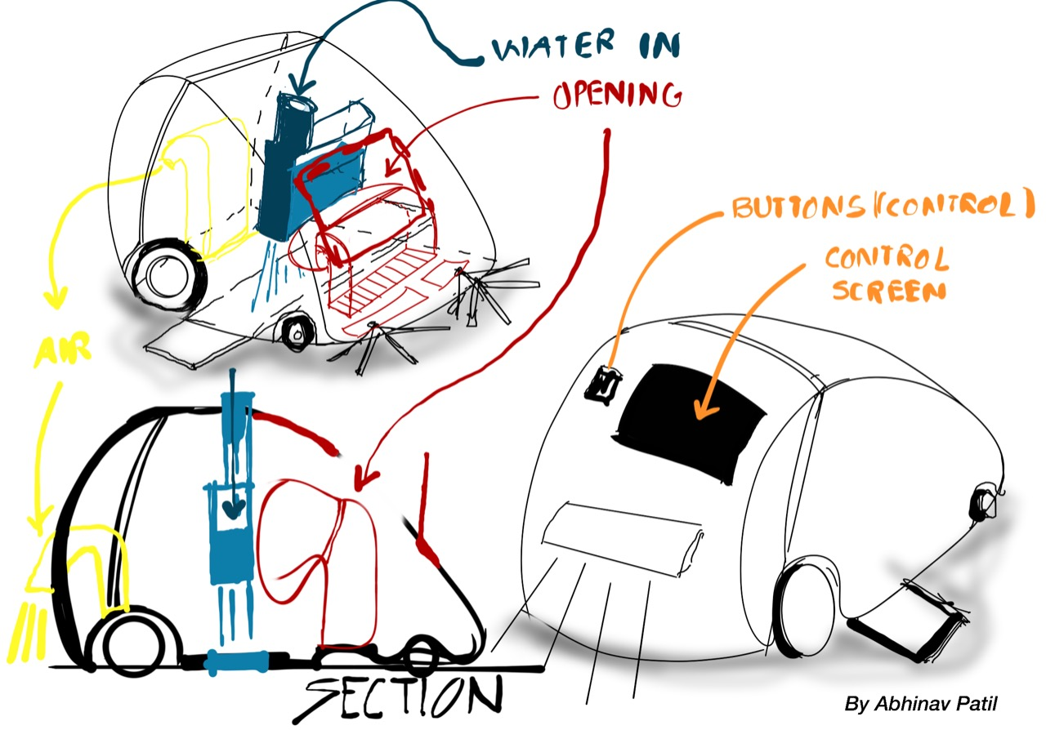
Proposed Design

Slide 10
Project timeline
Week 1
Week 2
Week 3
Week 4
Research & Planning
Robot Design Preparation
Circuit and Software Simulation
Final Concept Presentation and Research Paper Publication

Slide 11
Cycle diagram
04
Prototype
Refine
01
03
Display
Get feedback
02

Slide 12
Thank you!

